Slide 1
sIVASANKARAn p Business Intelligence Consultant
+91 8489765414 sivasankaran141096@gmail.com linkedin.com/in/sivasankaran-pitchandi-273721182
KEY SKILLS:
Business Intelligence
Data Analytics & Modeling
Microsoft Power BI
Microsoft Power Apps
Microsoft Power Automate
Data Analysis Expressions
SQL
CAREER PROGRESSION:
PwC (Aug 2021-Present) (PricewaterhouseCoopers Private Limited)
Consultant (Aug 2021- Present)
Capgemini (Oct 2018- Aug 2021)
Associate Consultant (Jan 2021- Aug 2021)
Senior Analyst (Jan 2020- Dec 2020)
Analyst (Oct-2018-Dec 2019)
PROFESSIONAL SUMMARY: Microsoft Certified: Data Analyst Associate and Power Platform Expert with nearly 3 years of experience in implementing analytical and reporting solutions. Experienced in leading a Business Intelligence team and performing data analysis, modeling and creating meaningful insights for clients from various domains.
PROFESSIONAL EXPERIENCE: Business Intelligence Consultant at PwC- (Aug 2021 – Present)
Experience in all Phases of Project Lifecycle Including Requirement gathering, design, develop and deploy business intelligence solutions.
Extensive experience in the Microsoft Power Platform: MS Power BI , Power Apps and Power Automate.
Expertise in End-to-End Development in Microsoft Power Platform.
Experience in leading a team and Manage the project as Product Owner.
Expertise in data analysis, modeling and interpretation using Microsoft Power Platform and SQL.
Expertise in creating data models, reports and dashboards in Power BI.
Expertise in creating Calculated columns and measures using DAX in Power-BI.
Experience in creating the Bookmarks, incremental refresh and RLS (Row level security) in Power BI.
Expertise in Power Apps formulas and development methods to develop canvas and model driven apps.
Expertise in Integrating Power BI Reports and dashboards into Power Apps.
Experience in T-SQL and SQL query, developing ETL strategies using SSIS, Database designing using SQL Server.
Knowledge in ETL pipelines to ingest and egest data stored on cloud/premise using SSIS and ADF.
Ability to work in an agile environment with a focus on continuous improvement.

Slide 2
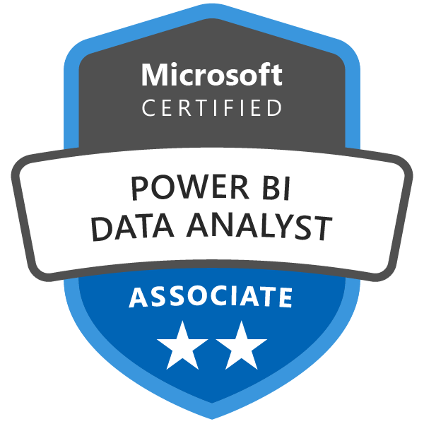



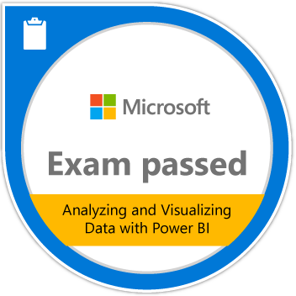
CERTIFICATIONS & EXAMS:
DA 100: Microsoft Certified: Data Analyst Associate. (May 2021)
70-778: Analyzing and Visualizing Data with Microsoft Power BI. (May 2020)
PL 900: Microsoft Certified: Power Platform Fundamentals. (February 2021)
DP-200: Implementing an Azure Data Solution. (November 2020)
AZ 900: Microsoft Azure Fundamentals. (September 2020)
ACADEMIC BACKGROUND:
BE - EEE, RMD Engineering college- Chennai. CGPA = 7.7/10 (Aug 2014- May 2018)
HSC- SRV Excel Matric Hr. Sec School- Namakkal. Percentage= 86.08 %
SSLC-SRV Excel Matric Hr. Sec School- Namakkal. Percentage= 92.8 %
RECENT PROJECT EXPERIENCE:
Job Title : Business Intelligence Consultant & Product Owner Project Sector : Fast-Moving Consumer Goods(FMCG) Project Domain : E-Commerce. Duration : October 2021 to Present
Business Scope: Use Business Intelligence to develop power BI reports which brings meaningful insights of overall Performance in terms of Product sales, orders ,inventory and shopper visits data.
Proposed Solution: Implemented both predictive and descriptive analytics to bring meaningful insights which fulfills all the Key Performance indictors for business to take better decisions. Benefits: Digital marketing team uses our reports to take decision easier for all the business needs. Few of them were listed below, 1. Running campaigns to scale up the sales. 2. Maintain cent % Stock available in Digital platforms by Raising POs in timely manner. 3. Track the Visit and sales trend in various aspects to enhance or scale up the business. 4. Performance of Delivery Partners and tracking the Product delivery from End to End.
ACHIEVEMENTS:
Recognized as XtraMiler for the Outstanding performance and lasting contribution- Mar 2021
Received Best team award in quality Delivery Excellence – Dec 2020.

